Slide 1

10-K Whisperer
Group No.
Avadhoot Virkar - 22107064
Chinmay Pawaskar - 22107066
Soham Shigvan - 22107001
Monish Mudaliar - 22107024
Project Guide
Prof. Depali Gat

Slide 2
Contents
Abstract
Introduction
Motivation
Objectives
Research Gap
Problem Definition
Scope
Technological Stack
Implementation
Conclusion

Slide 3
Abstract
This project presents the development of an AI-based financial document analysis system, “10-K Whisperer,” designed to simplify the understanding of complex financial reports such as annual filings and 10-K documents. The system uses a Retrieval-Augmented Generation (RAG) approach along with Natural Language Processing (NLP) techniques to extract, process, and analyze information from uploaded PDF files.It includes stages such as document parsing, text chunking, embedding generation, and semantic retrieval using a vector database. The system generates a 3-point executive summary and provides accurate answers to user queries based on the document content.The results demonstrate efficient information retrieval and reduced manual effort in analyzing lengthy reports. Overall, the project highlights a lightweight and practical AI solution in finance with scope for future enhancements.

Slide 4
Introduction
This project focuses on developing an AI-based system that helps users understand complex financial documents easily. It uses NLP and RAG techniques to extract meaningful insights from large PDF reports.The system allows users to upload financial documents and interact with them through a chat interface. It aims to reduce manual reading effort and provide quick, accurate, and context-based information.
Motivation :
Reduce the time and effort required for manual content creation by automating text generation using AI techniques.
Develop an intelligent system that can generate coherent and meaningful text, improving productivity in tasks like report writing and communication.

Slide 5
Objectives
To design an AI system for analyzing financial documents
To implement Retrieval-Augmented Generation (RAG) for document understanding.
To generate a concise 3-point executive summary from financial reports
To enable context-aware question answering based on document content

Slide 6
Research Gap(Limitations of existing systems)
Financial documents are difficult to interpret manually
Existing tools lack real-time interaction
Many systems require complex setups and heavy computation
Lack of lightweight AI solutions for document understanding
Limited explainability and user-friendly interfaces

Slide 7
Problem Definition
Financial reports are lengthy and complex
Users struggle to extract key insights quickly
Manual reading is time-consuming and inefficien
Existing systems do not provide context-aware answers
Need for an intelligent system to simplify financial analysis

Slide 8
Scope
Can be used for analyzing financial reports and filings.
Useful for students, analysts, and investors.
Can be extended for multi-document comparison.
Can integrate advanced LLMs for better accuracy.
Potential use in fintech and banking applications.

Slide 9
Technological Stack
Frontend: Streamlit
Backend: Python
Environment: VS Code / Jupyter
PDF Processing: PyPDFLoader / PyPDF2
Embeddings: HuggingFace (MiniLM)
Vector DB: FAISS
LLM: Gemini / OpenAI

Slide 10
Implementation
Figure 1. AI Text Generator User Interface with Generated Output

Slide 11
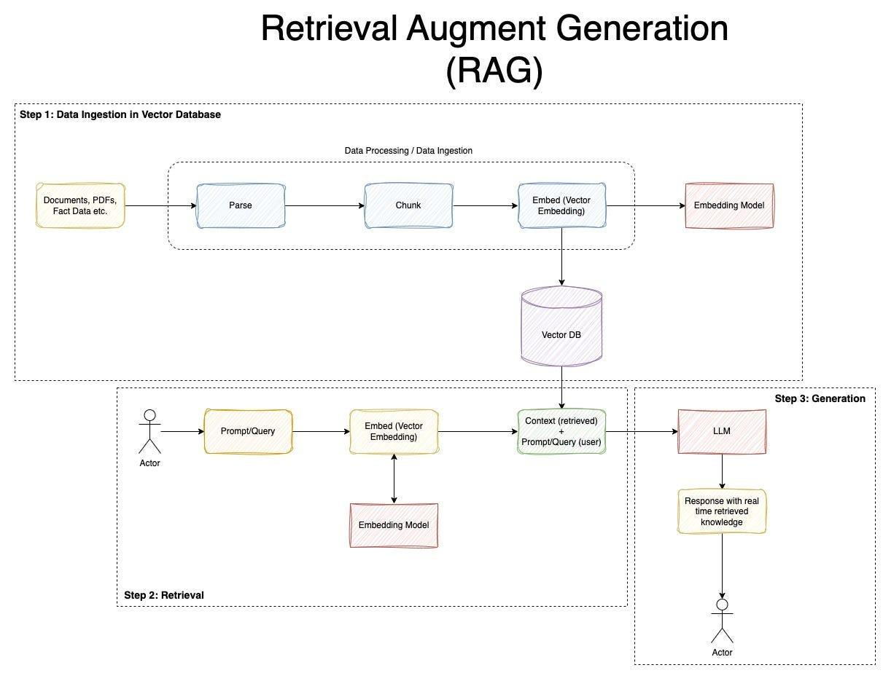

Slide 12
Conclusion
The “10-K Whisperer” successfully demonstrates how AI and NLP can simplify financial document analysis. The system efficiently extracts key insights and provides context-aware answers using a RAG-based approach.It reduces manual effort and improves accessibility of financial information. The project serves as a strong foundation for future improvements using advanced AI models and scalable architectures.

Slide 13
Thank You...!!

